Slide 1
Computer network session 9
DOMAIN NAME SERVICES
Santoso Budijono

Slide 2
Learning outcomes
LO 1: Describe basic structures of network
LO 2: Explain basic concepts of network
LO 3: Design network environment using TCP/IP Model

Slide 3
topics
Hieararchy – Naming system
Process :
- Name Service
- DNS

Slide 4
dns
Role of Name system
An application has to know the IP adress of its counterpart.
IP addressis used for routing and not suitable for human.
Human can remember names
A name must be unique.
The use of name instead of IP address is called Domain Name System (DNS).
A name is constructed of alphanumeric and consists of several hirarchical elements to show domain and the computer (host) itself.
Domain Name Server (DNS) is used to find IP address of a certain domain name

Slide 5
dns
Name format
The right element is called Top level atau ZONE
The next segment is called DOMAIN (domain.zone) and regulated by ICANN. It must be uniques.
There are two Top-Level Domain (TLDs):
  TLD generik
    COM, .NET, .ORG, .EDU, .INT, .MIL and .GOV.
    New : .aero, .biz, .coop, .info, dsb.
  Country code (.uk, .de, .jp, .us, .tv, etc.)

Slide 6
dns
Domain name system
Top Level Domains are in the top and the maximum tree depth is 128
Domains are sub trees (.edu, univ.edu, ece.univ.edu)
Name collisions must be avoided.
DNS system consists of three component:
  DNS data (Resource Records)
  Servers (Name Servers)
  Protocol
No centralized DNS due to the probability of one point failurer, traffic volume, maintenance.
Distributed Database
root
edu
com
gov
mil
org
net
uk
fr
univ
mit
cs
ece
si
x
y
y

Slide 7
dns
Dns data
DNS databases have more information apart from hostname-to-address.
  Name server records NS
  Hostname aliases CNAME
  Mail Exchangers MX
  Host Information HINFO

Slide 8
dns
Address resolution
Mapping a name to an address or an address to a name is called name-address resolution.
Two Type of Resolution
- Recursive Resolution
- Iterative Resolution

Slide 9
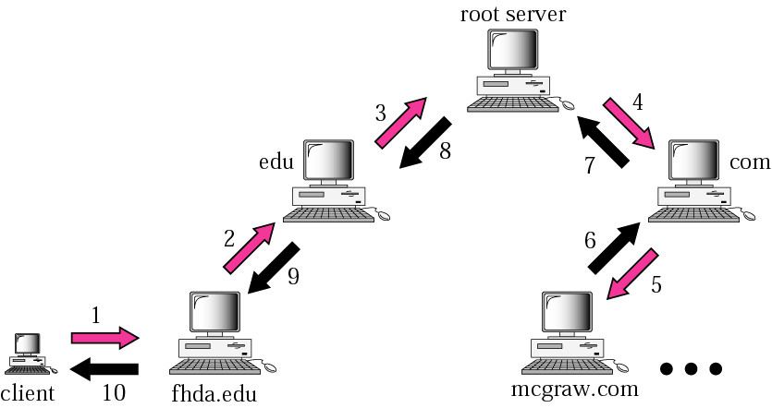
dns
Recursive resolution
DNS server
DNS server
DNS server
DNS server
DNS server
PC client connect to network of fhda.edu
Want to browse or get data from mcgraw.com

Slide 10
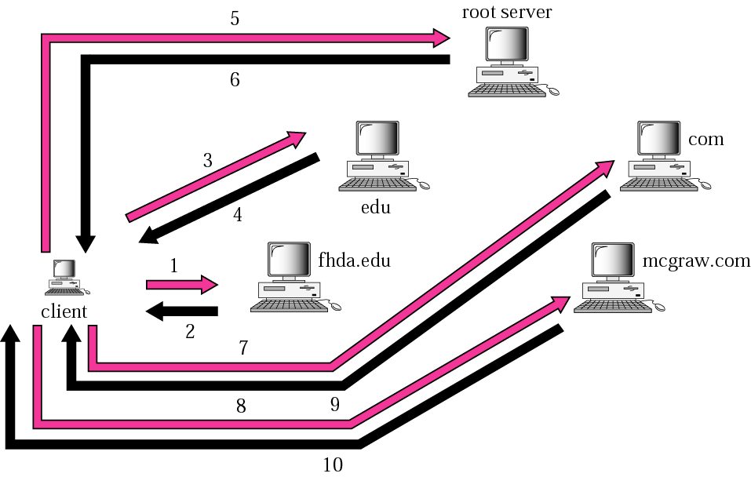
DNS
Iterative resolution
DNS server
DNS server
DNS server
DNS server
DNS server
PC client connect to network of fhda.edu
Want to browse or get data from mcgraw.com

Slide 11
dns
At cloud
DNS server in AWS called “Amazon Route 53”
Is used to route end users to internet applications by translating names (like www.example.com) into numeric IP addresses (like 192.0.2.1) that computers use to connect to each other
Is fully compliant with IPv4 and IPv6
Connects user requests to infrastructure running in AWS and also outside of AWS
Is used to check the health of your resources
Features traffic flow
Enables you to register domain names

Slide 12
exercise
Explain DNS process if client at abc.go.id to xyz.co.id, using Iterative process ?

Slide 13
References
Forouzan, B. A. (2021). Data Communications and Networking with TCP/IP Protocol Suite. 6th Ed. New York: McGraw-Hill. ISBN: 978-1-26-436335-3.

Slide 14
Thank you
December 2024

